Slide 1

DISCLAIMER
The information in this presentation is provided to you by PT. AXAR Technology Raya, solely for informational purposes and does not constitute an offer to buy, sell or issue, or a solicitation of an offer to sell, buy or acquire any securities of the Company in any jurisdiction or an inducement to enter into investment activity, nor may it or any part of it form the basis of or be relied on in connection with any contract or commitment whatsoever. No representations or warranties, express or implied, are made by the Company, any underwriters, any of their respective affiliates, directors, officers, employees, advisors or representatives with respect to, and no reliance should be placed, on the accuracy, fairness or completeness of the information presented or contained in this presentation. By viewing this presentation, you agree that none of the Company, any underwriters, nor any of their respective affiliates, directors, officers, employees, advisors or representatives accepts any responsibility or liability whatsoever for any loss howsoever arising from any information presented or contained in or derived from or omitted from this presentation. The information presented or contained in this presentation was obtained from various sources, including certain third parties, and has not been independently verified, and its accuracy is not guaranteed.
This presentation does not contain all relevant information relating to the Company or its securities, particularly with respect to the risks and special considerations involved with an investment in the securities of the Company. These materials are not an offer of securities for sale. Any public offering will be made by means of a prospectus that may be obtained from the issuer and that will contain detailed information about the company and management, as well as financial statements. This presentation speaks as of its date and the information presented or contained in this presentation is subject to change without notice or update.
This presentation contains statements that constitute forward-looking statements. These statements include descriptions regarding the intent, belief or current expectations of the Company or its officers about the future. These statements can be recognized by the use of words such as “expects,” “plans,” “will,” “estimates,” “projects,” “intends,” or words of similar meaning. Such forward-looking statements are not guarantees of future performance and involve risks and uncertainties, and actual results may differ from those in the forward-looking statements as a result of various factors and assumptions, many of which are beyond the Company’s control. The Company or any of its affiliates, advisors, representatives or underwriters has no obligation and does not undertake to revise forward-looking statements to reflect future events or circumstances.
THE INFORMATION CONTAINED IN THIS DOCUMENT IS HIGHLY CONFIDENTIAL AND MAY NOT BE FORWARDED, PUBLISHED OR DISTRIBUTED, DIRECTLY OR INDIRECTLY, TO ANY OTHER PERSON (WHETHER WITHIN OR OUTSIDE YOUR ORGANIZATION/FIRM) FOR ANY PURPOSE AND MAY NOT BE REPRODUCED IN ANY MANNER WHATSOEVER. ANY FORWARDING, PUBLICATION, DISTRIBUTION OR REPRODUCTION OF THIS DOCUMENT IN WHOLE OR IN PART IS UNAUTHORIZED.
WEB
DEVELOPMENT (Backend)
MODUL 1

Slide 2
OBJECTIVES
Development tools dan komponen-komponennya.
Ekosistem Javascript: ES, JS, Node.js, Browser, HTML, CSS.
Dasar-dasar javascript
Javascript untuk browser dan di luar browser
Tools dan utilities
Konstruksi dasar Bahasa pemrograman Javascript
Notes:
Save Time....:
The Platform will house/aggregate thousands of DIRECT SUPPLIERS. Buyer members are now abled to easily Pick whats best suitable for them.
Discover...:
Suppliers need to be a registered and verified members. There will be features such as ratings and certifications to boost further.
Grow Business:
Members akan di-empowered dengan sebuah tool digital yang yang tadinya menyerang industri, malah justru membuat mereka bisa menjadi lebih kompetitif di era digital.

Slide 3
Development tools dan komponen-komponennya

Slide 4




Text/Code Editor

Slide 5



Version Control

Slide 6
Ekosistem Javascript

Slide 7
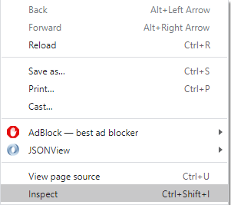
Javascript di Browser
Buka peramban/browser (chrome atau firefox)
Klik kanan, pilih Inspect (Ctrl+Shift+I)
Pilih Console

Slide 8

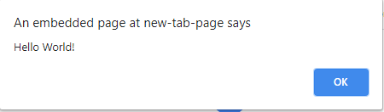
Javascript di Browser
Menampilkan pesan melalui console
Menampilkan alert di browser

Slide 9
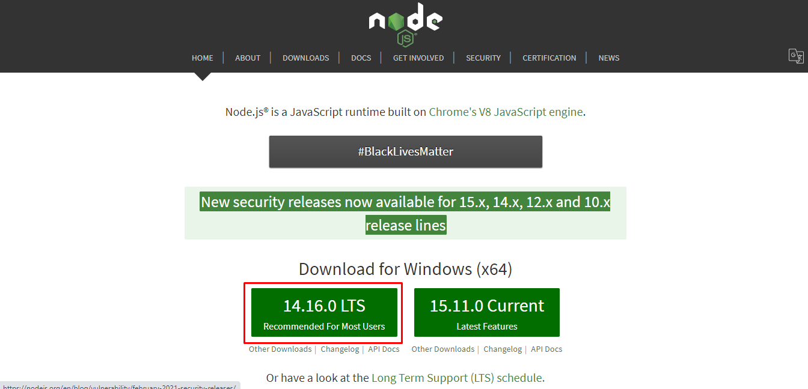
Javascript di luar browser
Download dan install node js

Slide 10
Dasar Javascript

Slide 11
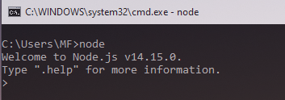
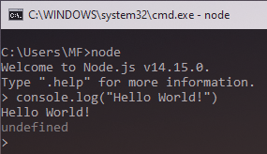
Javascript di luar browser
Buka command prompt
Jalankan perintah “node”
Jalankan syntax
console.log(“Hello World!”)

Slide 12
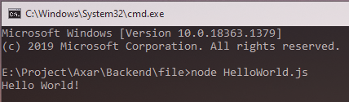
Javascript di luar browser
Atau dengan cara membuat file .js menggunakan text editor. Kemudian akses folder melalui command prompt dan jalankan perintah
node [namafile].js

